Slide 1

Decentralized IoT Solution for Smart Agriculture Using Edge Computing
GUIDE NAME:
Prof. M. Jeyapandian
Asst. Professor-II
STUDENT NAME:
Kishore B
225003069

Slide 2
Table Of CONTENTS
Base-paper Title and Info
Abstract
Problem Statement
Literature Survey
Workplan
Methodology
Output
Conclusion

Slide 3
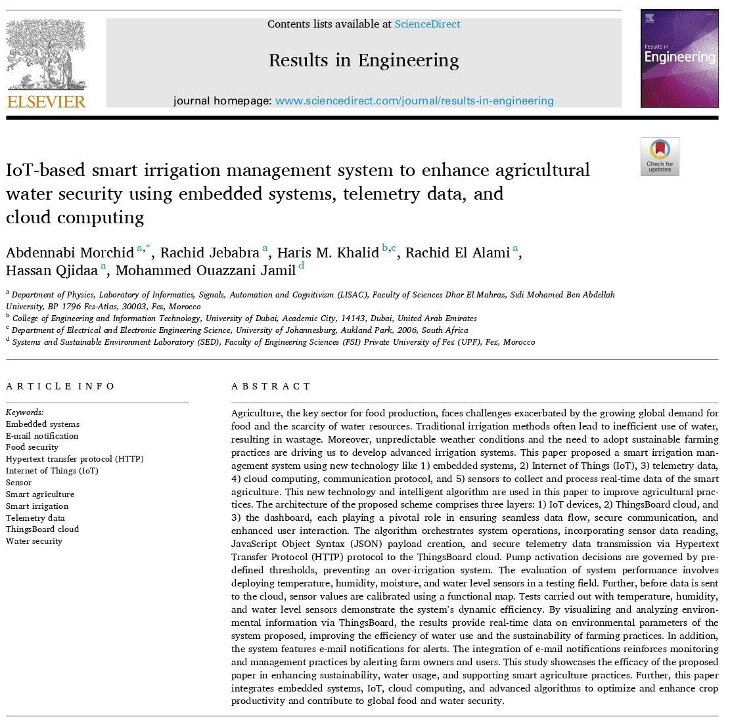
Base Paper Title:
IoT-based smart irrigation management system to enhance agricultural water security using embedded systems, telemetry data, and cloud computing
Authors: Abdennabi Morchid Hassan Qjidaa, Rachid Jebabra, Haris M. Khalid, Mohammed Ouazzani Jamil, Rachid El Alami
Source: ScienceDirect

Slide 4
Perspective of
Cloud Computing

Slide 5
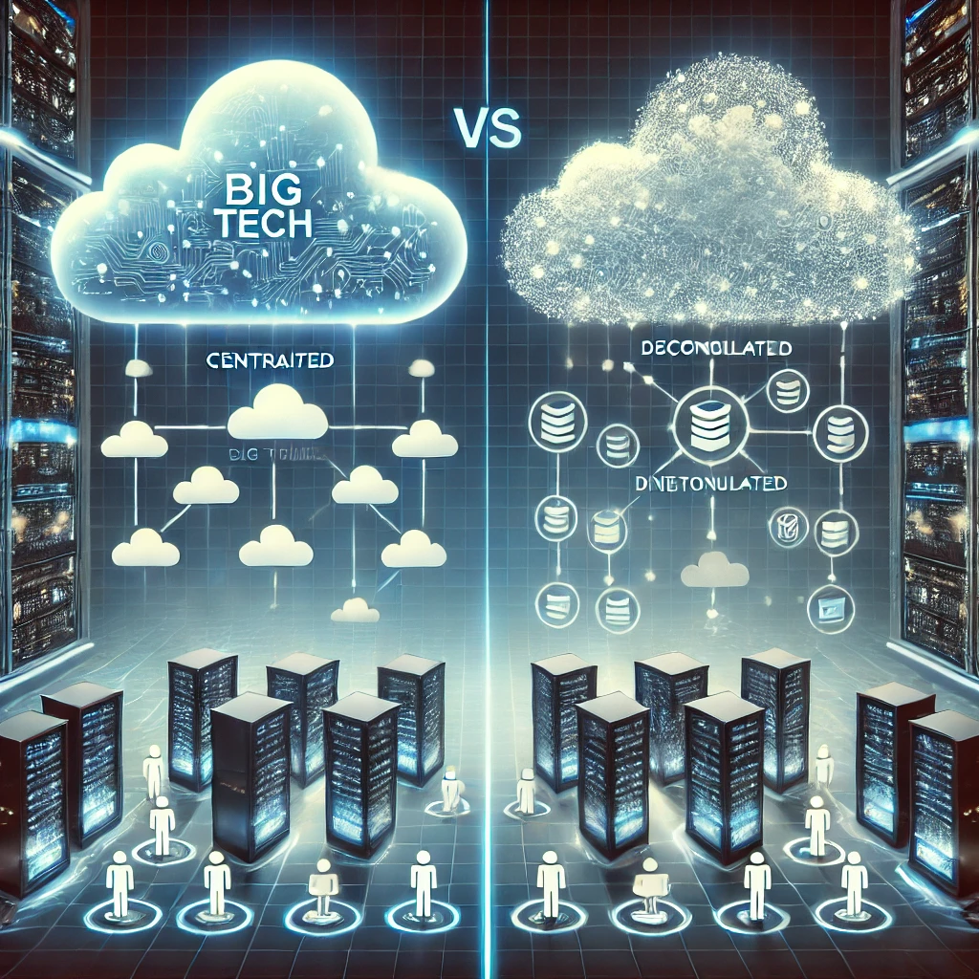
Future Of Cloud Computing
Centralized vs. Decentralized Cloud
Cloud computing's future is a tug-of-war between two architectural models:
Centralized
Decentralized
-Tim Berners-Lee (Inventor of the Web)
Berners-Lee introduced Solid, an open-source project aimed at giving individuals control over their data

Slide 6
Future Of Cloud Computing
The Rise of Decentralized & Personal Cloud Servers
Personal Cloud Servers – Individuals/companies hosting their own private cloud (e.g., Nextcloud, Syncthing).
Peer-to-Peer Cloud Storage – Data stored across a network of devices, not in centralized data centers (e.g., IPFS, Storj, Filecoin).
✅ Full Data Ownership – No third party controls your files. ✅ Cost Savings – “Avoid expensive cloud subscriptions” in the long run. ✅ Better Privacy & Security – No centralized entity has access to all your data.

Slide 7
Perspective of Web
Development

Slide 8
Web 1.0 vs Web 2.0 vs Web 3.0
Web 1.0 (Static Web) – 1990s to early 2000s
Read-Only: Users could only consume content, not interact with it.
Static Websites: Basic HTML pages with minimal interactivity.
Centralized Control: Content was controlled by website owners, no user-generated content.
Examples: Early Yahoo, Netscape, Britannica Online.

Slide 9
Web 1.0 vs Web 2.0 vs Web 3.0
Web 2.0 (Social & Interactive Web) – 2000s to Present
Read-Write: Users can create and share content (blogs, social media, wikis).
Dynamic & Interactive: Websites became more user-friendly and responsive (AJAX, JavaScript, CSS).
User-Generated Content: Platforms like Facebook, YouTube, Wikipedia, and Twitter thrived.
Centralized Platforms: Tech giants control major platforms, monetizing user data.

Slide 10
Web 1.0 vs Web 2.0 vs Web 3.0
Web 3.0 (Decentralize) – Emerging Trend (Purely based on decentralized cloud servers)
Read-Write-Execute: Smart applications with Networks where only users can manage their data and resources on their server.
Decentralization: No centralized servers, Each users will have their own mobile servers that they can carry where ever they want.
Companies-Working-On: Roblox, Google

Slide 11
Abstract
Existing smart irrigation systems face limitations such as dependency on third-party cloud services, inefficient water usage, limited connectivity, and lack of data privacy. These challenges often hinder the effectiveness and scalability of traditional solutions. To address these issues, this project proposes a decentralized smart irrigation system tailored for agricultural fields. By integrating private web-based monitoring and automated irrigation control, the system eliminates reliance on external cloud platforms, ensuring seamless and uninterrupted operation. This approach envisions a future where farmers have full control over their irrigation infrastructure, enabling real-time decision-making and optimizing resource usage. With enhanced autonomy, secure data management, and decentralized operation, it paves the way for more resilient, scalable, and self-sufficient agricultural practices, ultimately promoting sustainability and long-term efficiency in farming.

Slide 12
Problem Statement
Dependency on External Platforms and Data Privacy Concerns
Traditional smart irrigation systems often rely on third-party cloud services for data storage, processing, and decision-making. While this approach enables remote monitoring and control, it raises significant concerns regarding data privacy and security. Previous research on IoT-based irrigation models highlights that storing sensitive agricultural data on external servers exposes it to potential breaches, unauthorized access, and data misuse. Additionally, the reliance on cloud-based platforms increases operational costs and creates dependency on service providers, which can lead to service disruptions if the platform experiences downtime or policy changes. These limitations underscore the need for decentralized solutions that allow farmers to retain control over their data while ensuring secure and efficient irrigation management.

Slide 13
Literature Survey
S.No | Title | Methodology | Merit | Demerit
1. | AUTOMATIC IRRIGATION SYSTEM - Department of Information & Communication Technology Comilla University – [2024] | Arduino Uno controls soil moisture sensors to automate irrigation. A relay module operates a water pump, ensuring plants get water only when needed. | Water-saving Efficient Water Control | No Remote Control or Monitoring
2. | Automatic Irrigation System using Soil Moisture Sensor – Link – [2023] | Arduino Uno reads soil moisture levels and controls a relay-operated water pump for automated irrigation, reducing water waste and manual effort. | Simple to implement | No Remote Control or Monitoring

Slide 14
Literature Survey
S.No | Title | Methodology | Merit | Demerit
3. | Smart irrigation system based on IoT and machine learning – Science Direct – [2022] | IoT sensors collect soil, temperature, and rain data. Machine learning models (KNN, SVM, Neural Networks) predict irrigation needs, optimizing water efficiency and automation via Node-RED and MongoDB. | Uses ML model Uses DB | No Remote Control or Monitoring Non interactable
4. | IoT based Smart Irrigation System using Soil Moisture Sensor and ESP8266 NodeMCU – circuitdigest.com link – [2021] | ESP8266 NodeMCU reads moisture, temperature, and humidity. Data is sent to ThingSpeak, and the pump operates automatically based on moisture levels. | Remote Monitoring More features sensed User Friendly | No privacy [ThingSpeak used] Only useful for small lands

Slide 15
Literature Survey
S.No | Title | Methodology | Merit | Demerit
5. | IoT based Smart Irrigation System – [Electrical Engineering Department, Egyptian academy for engineering and advanced technology] – [2022] | IoT sensors monitor soil, temperature, and rain. ESP32 microcontrollers process data for automated irrigation, controlled via mobile/web apps using MQTT protocol. | Remote monitoring Cheaper MC Used | No privacy [Third party Brokers used]
6. | IoT and Cloud Based Sustainable Smart Irrigation System – E3S Web of Conferences 472 – [2023] | IoT sensors monitor soil moisture and weather. NodeMCU processes data and controls irrigation via cloud-based automation, optimizing water use and enabling remote access. | Remote Control Cost-saving | High setup cost Heavy MC used

Slide 16
Methodology
The system consists of a Raspberry Pi as the master node and multiple ESP32-based slave nodes, each equipped with a soil moisture sensor and a sprinkler. These nodes are strategically placed across the field and communicate with the Raspberry Pi using wireless data transmission techniques(Here WiFi is used for Communication).
Every 5 minutes, the ESP32 nodes measure the soil moisture levels and send the data to the Raspberry Pi, which updates it on a webpage for the landowner to monitor in real time. When the moisture level drops below a set threshold, the sprinkler automatically activates and remains on until the soil reaches the required moisture level, ensuring optimized irrigation.
This method enables automated water management, reducing manual effort and water wastage while providing a smart, decentralized, and efficient irrigation system.

Slide 17
Available Techniques for Web Hosting
Tunneling
Pure
Tunneling
Reverse Proxy Hosting
Port Forwarding

Slide 18
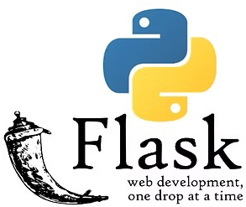
Flask for Local Hosting
Lightweight and efficient – perfect for Raspberry Pi.
Seamless integration with Python scripts
Minimal setup with built-in development server.
Supports quick updates and real-time data display
Easy data handling using Python objects

Slide 19

Why NGROK?
Bypasses Need for complex IP port forwarding
Instant exposure of local server to internet
Secure tunnelling
Generates Unique URL
Great for small data transmission
Can be used also for static websites

Slide 20

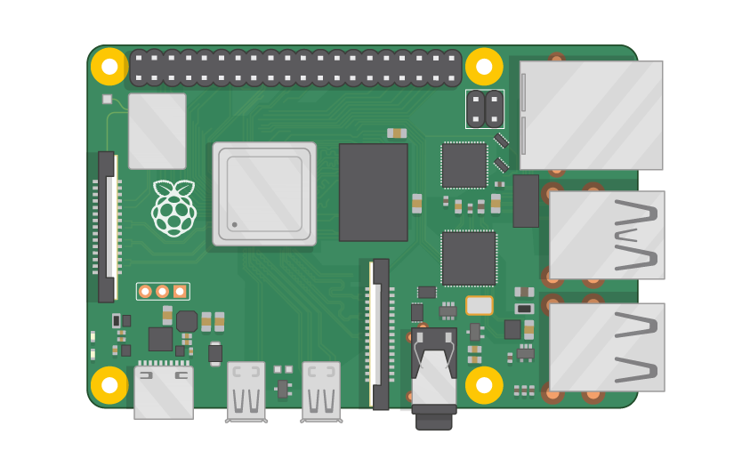


Data flow - Visualization
Moisture Level
Via Wifi
To Local Server
Hosted On Internet
Tunneling

Slide 21
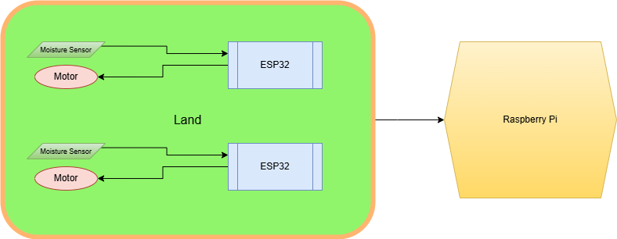
Architecture

Slide 22
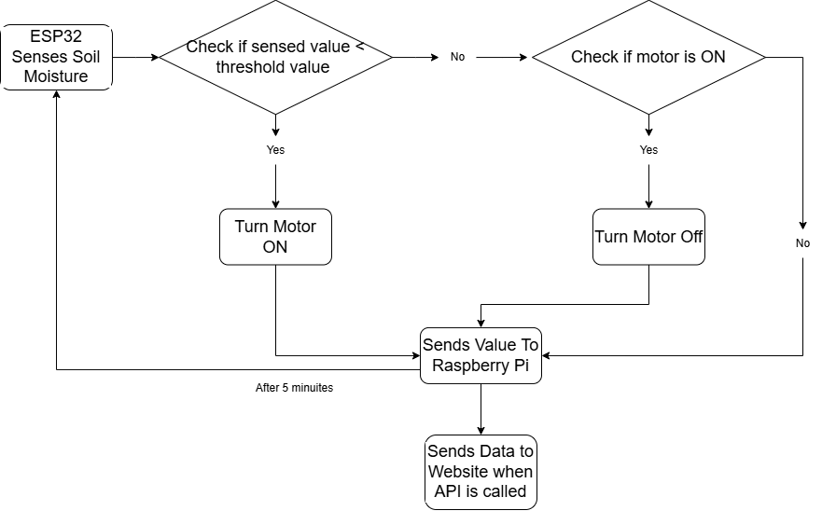
Workflow

Slide 23


Problems Faced
FILE LOCKING SYSTEM
WLAN – Single Wi-fi Connection

Slide 24
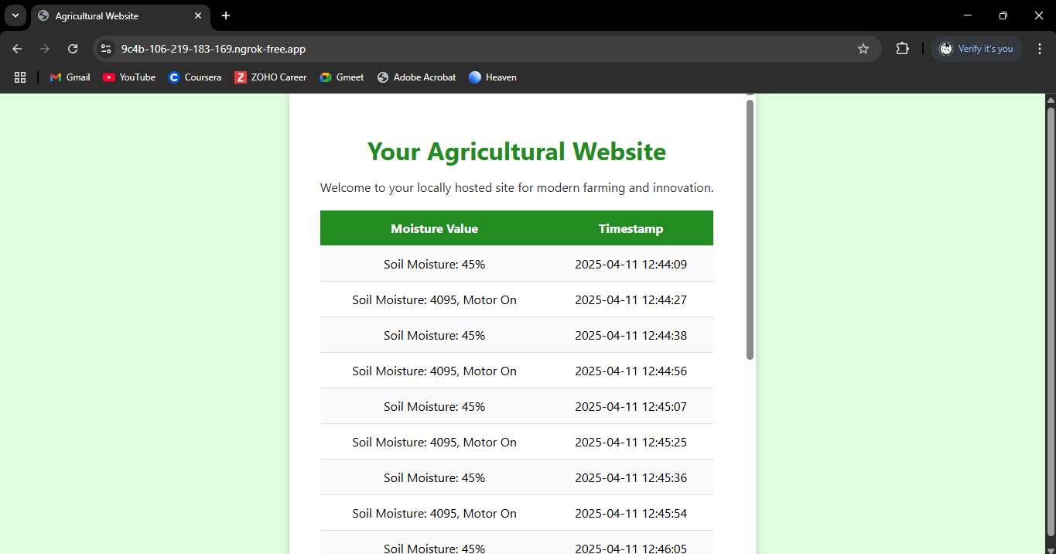
Output

Slide 25
Workplan
0th Review
Prepare Ideation
1st Review
Connection between Raspberry Pi and Esp32
2nd Review
Configure RaspberryPi as Web Server
Create PPTs
Draft Workplans
Implement detection and pump control
Complete IoT Physical
Document Submission
Complete Web Development Works

Slide 26
Conclusion
The system I’ve built with decentralized web hosting could be seen as an early version of how future cloud computing might work — more private, more secure, and fully under the user's control.
For this review, I’ve completed the core IoT functionality, and before the final review, I’ll be focusing on adding more features — like integrating extra sensors into each node — to make the system even more efficient and intelligent.

Slide 27


